Slide 1
Provides a continuous supply of ready to use product on demand
Water-driven, non-electric
Durable molded construction
Easy to install
Integrated backflow protection
Light weight
Cost effective

Slide 2
How It Works
1. Water enters the system, flowing through a venturi eductor.
Water In
2. Concentrated chemical is pulled into solution through a metering orifice designed to meter 25, 50 or 100 PPM and is pre-diluted, filling the reservoir.
3. Once the reservoir is filled, the water valve is shut off by Hydro Systems time tested and robust HydroMinder float valve.
Mixed
Product
Out
Water In
4. The pre-diluted solution is picked up using a water driven injector and re-diluted at its ready-to-use strength in parts per million. (several injector options available based on specific application, up to 64,800 gallons per day or 2,700 gallons per hour peak flow.)
Conc. Chemical
5. As the reservoir is depleted, the HydroMinder float lowers opening the water valve, to refill the system again. No user interaction is required until the concentrate jug needs to be replaced.
HydroMinder Float Valve

Slide 3
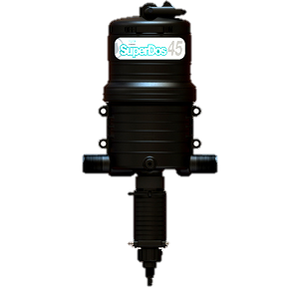
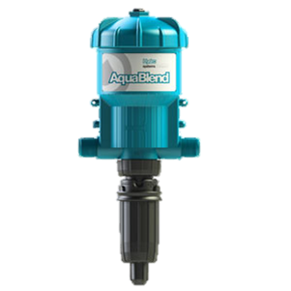
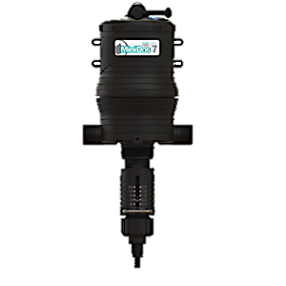
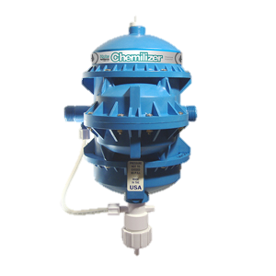
The Continuous-Blend System can also be wall-mounted when using larger concentrate containers (15 gallon drums).
Hydro Systems offers a wide range of water driven injectors that can be used with the Continuous-Blend System. These injectors are completely water driven and accurately deliver chemical, proportional to the flow of water coming in to the system.

